Slide 1
Missing Data: Over-re-view
Notes:
Read Before Class:
Section 5.1 Using the Standard deviation to Standardize Values
Section 5.2 Shifting and Scaling
Section 5.3 Normal Models
Section 5.4 Working with Normal Percentiles
Section 5.5 Normal Probability Plots

Slide 2
Most Important Lesson
Handling missing data is more of a conceptual problem than a technical one.
  YOU must make decisions.
  YOU must know the consequences of your decisions
  YOU must communicate decisions.

Slide 3


The Data Flow
SQL
Start
Database/Research
Design
Data
Collection
Data
Storage
Data
Retrieval
Data
Wrangling
A Flat File
Data
Cleaning
Missing
Data
Draft
Modeling
File
Model Specific
Pre-Processing
Modeling
File
Modeling
Reporting

Slide 4
The Data Flow: Is it Really Linear?
Start
Database/Research
Design
Data
Collection
Data
Storage
Data
Retrieval
Data
Wrangling
Flat File
Data
Cleaning
Missing
Data
Draft
Modeling
File
Model Specific
Pre-Processing
Modeling
File
Modeling
Reporting

Slide 5
Common Missing Data Nomenclature
Missing Completely at Random | Missing at Random | Missing Not at Random
The missingness of data is unrelated to both the observed and unobserved data. The data are literally, MCAR. | The missingness of data is related to the observed data but not to the unobserved data. MAR missingness depends only on the observed data and can be predicted by other variables in the dataset. | The missingness of data is related to the unobserved data, even after conditioning on the observed data. This means that the probability of missingness depends on the values of the missing data itself, even after accounting for the observed data. MNAR is the most problematic missing data mechanism as it implies that the missing data cannot be explained by the observed data

Slide 6
Data Cleaning Steps
Open data in your software of choice
Review variables for common sense based on SME knowledge
Review how the software coded the variables (nominal, continuous)
Perform data integrity/validation checks (misspelled levels, bogus values, combine levels which represent the same thing, etc.)
Handle dates (extract relevant information, e.g. day of week, hour of day)
Handle categorical variables - keep as is, combine rare levels, combine similar levels
Handle zero-variance predictors, i.e., columns that contain the same number throughout
Handle near zero-variance predictors, i.e., columns that contain very little variety in values or who mostly contain a single value (very low information density)
Eliminate redundant columns and columns that are weighted sums of others.
Search for outliers and initial search for missing values
Sanity check using Decision Tree (1 to 2 splits)
Notes:
Review variables for common sense based on business knowledge
Review how JMP coded the variables (nominal, continuous)
Search for missing values
Determine a strategy
Implement strategy
Remember – “new” data must be treated the same way
Search for outliers
Evaluate distribution shapes
Bin where needed
Transform where needed
Evaluate Multicollinearity
Sanity check using Decision Tree
Data Cleaning Steps

Slide 7
Missing Data Steps
We join this program already in progress> DF = MDdf
Identify missing data
“Mark” missing data
Clean up any obvious mistakes (missing = 0)
Make easy decisions on Rows/Columns
Assess missingness pattern
Apply simple techniques
Apply complex techniques (MICE)
Sensitivity analysis
Report process
Export “Draft Modeling File”

Slide 8
Step 1: Identify missing data
  Pretty much already done by now
    Nice table to summarize
    Will look slightly different than first look do to elimination of rows/columns
  NOTE: is.na(), flextable, md.pattern(), md.pareto()

Slide 9
Step 2: “Mark” missing data (with 0,1)
Variation among the experts on importance (book doesn’t seem to make important). I think it is.
  Why is this important?
Line or two of code, various functions
How are you going to store the identifiers?

Slide 10
Step 3: Clean up any obvious mistakes (missing = 0)
May have done in Cleaning steps
  Does U = unknown, thus missing?
  Does blank = 0?

Slide 11
Step 4: Make easy decisions on Rows/Columns
If you haven’t already, mark for elimination various rows and columns
  Do you want to “delete” the column or just not use?
    Could be helpful for imputation?

Slide 12
Now the Hard Work Begins
P.S. Don’t forget Continuous Improvement

Slide 13
Step 5: Assess missingness pattern
We now must determine MCAR/MAR
  Little has a method, some things I read weren’t complimentary
  I choose to do the tests manually
    Learn more about the data
    There is an increased Type I error rate, but the consequences are low
  Logistic regression, Chi Square and other methods can be used
  I find a Decision Tree to be just fine and nice visually
    I used judgement, not statistical significance
  Again consequences are low for mistake because ….
    If we use more advanced methods, they assume MAR and thus handle MCAR just fine

Slide 14
Step 6: Apply simple techniques
These are univariate (one variable at a time) methods
  Check on which methods work only for MCAR
  First check …. “small” number of missing data
    This gets that variable “out of the way” for Multiple Imputation
  Second check could be variables with more missing, but SME indicates univariate imputation should be fine
    Need there not to be “many” missing values in the variable used to impute if a modeling method is used

Slide 15
Step 6: Apply simple techniques (cont.)
Non “modeling” methods
  Mean, median, mode
  Simple stochastic
  LOCF for time series
Modeling methods
  Any number of regression/ML techniques
    Choose based on understand of variables and class of variable being imputed
    Can be point estimate or stochastic
MICE package has options, but coding yourself will create understanding. It’s not hard.

Slide 16
Step 7: Multiple Imputation
Of MICE and Business Analytics Professionals
First and most different aspect
  We create m datasets, not one dataset
  Each dataset has the missing data imputed “differently”
We model on each dataset
We don’t “average” the datasets, we “average” the models

Slide 17
Step 7: Multiple Imputation – Some Terminology
m: the number of imputed datasets. For this class, m=10.
  Some theory can be used to determine m, but practical implications probably rule unless totally automated
Works for MCAR and MAR
I’m ignoring ignorability (MNAR?)
Q: quantity(ies) of interest, our parameters
Q: our sample estimate of Q
Unbiased: All estimates are wrong, but they can be right “on average”
Confidence Valid: “conservative” on variability and df estimates
  ???? What does this mean????

Slide 18
Step 7: Multiple Imputation – More Terminology
U: Variance or covariance matrix (sampling variation)
B: Variance caused by missing data
B/m: Variance caused by mputing the missing data
T: Total variance of Q_{hat}
Equation 2.20: T = U + B + B/m
= % of variation due to missingness
  = (B + B/m)/T

Slide 19
Step 7: Multiple Imputation - Patterns
Univariate and multivariate
  Don’t need MICE for univariate
Monotone or general
  Monotone is a unique situation not covered in this class
Connected or unconnected
  ???? No complete overlap of missingness????

Slide 20
Step 7: Multiple Imputation – “some” challenges (pgs. 111-112
Predictors of missing values can have missing values
Circular dependence. I need x2 to predict x2 but x2 has missingness and I need x3 to predict x2 but it has missingness
Different types of variables (categorical, quantitative, etc)
Imputation can create impossible combinations of variables

Slide 21
Step 7: Multiple Imputation: 2 of 3 methods
I skipped monotonic
Joint Modeling: imputations drawn from a multivariate model
Fully Conditional Specification: aka chained equations. Iterated conditional models.
  MICE is a Fully Conditional model.

Slide 22
Of MICE and Imputation

Slide 23
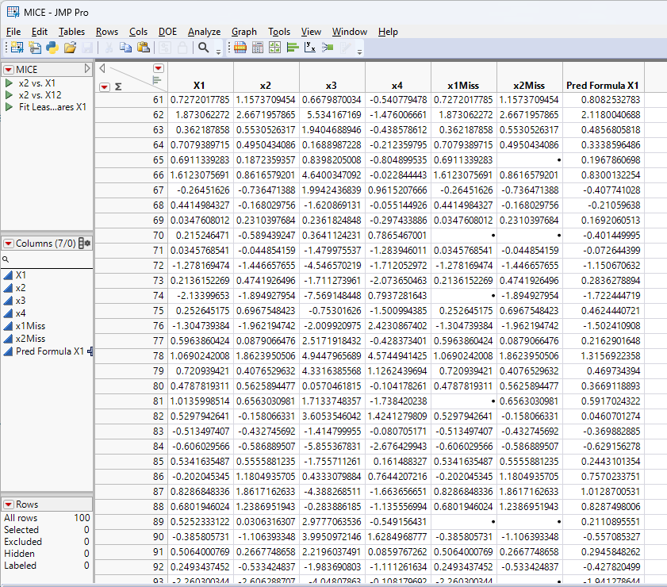
Toy Data

Slide 24
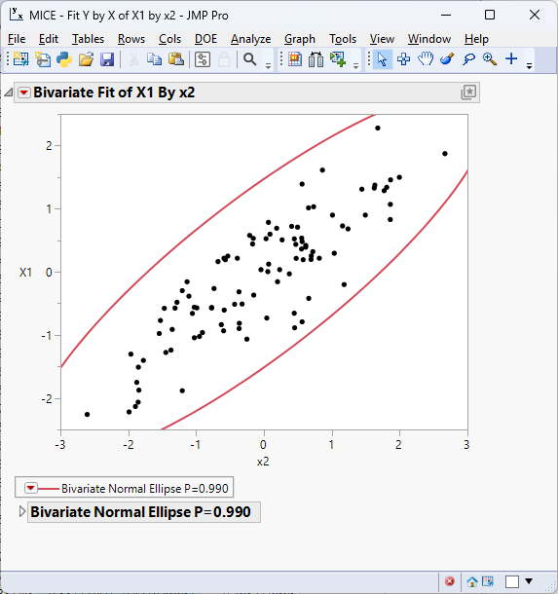
Relationship of x1 and x2

Slide 25

3D Relationship

Slide 26
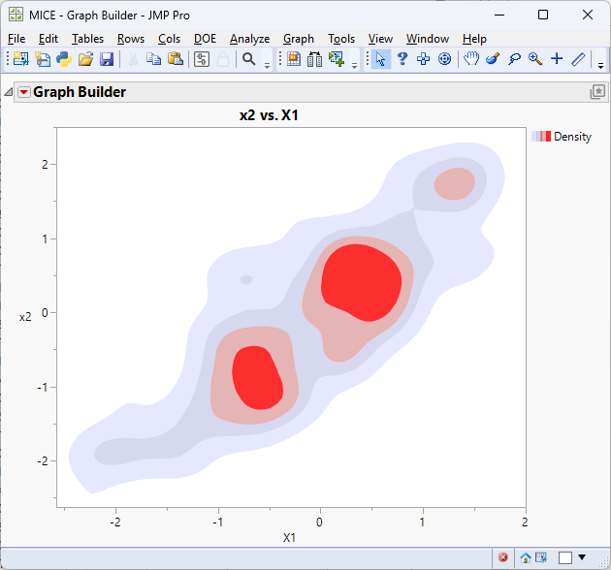
3Dish Relationship

Slide 27
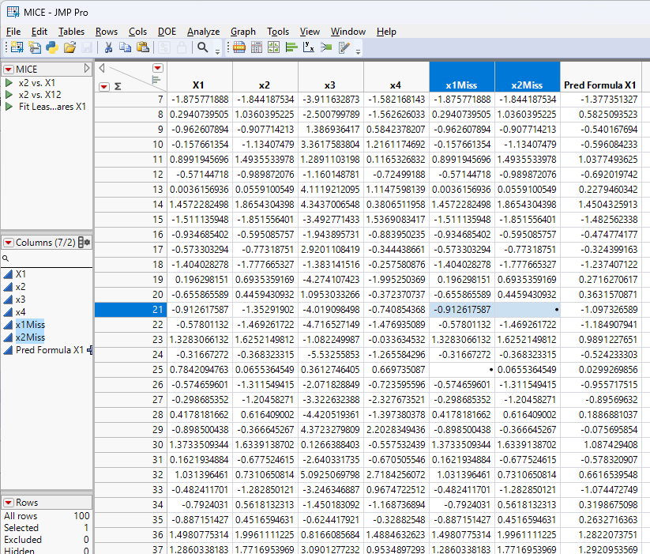
How Do I Impute This Number?

Slide 28
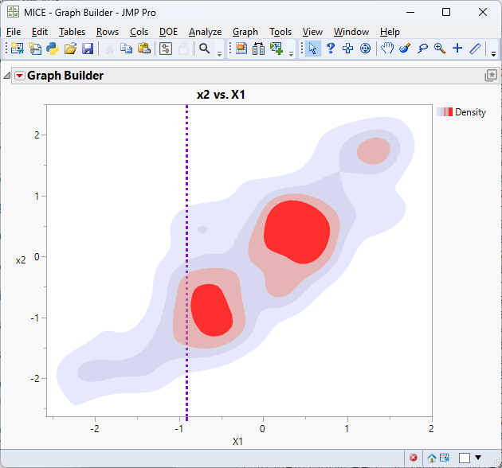
Conditional Distribution

Slide 29
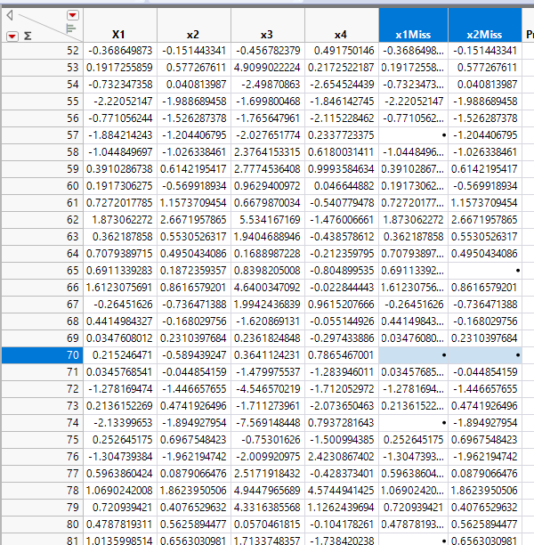
What if Both Numbers are Missing

Slide 31
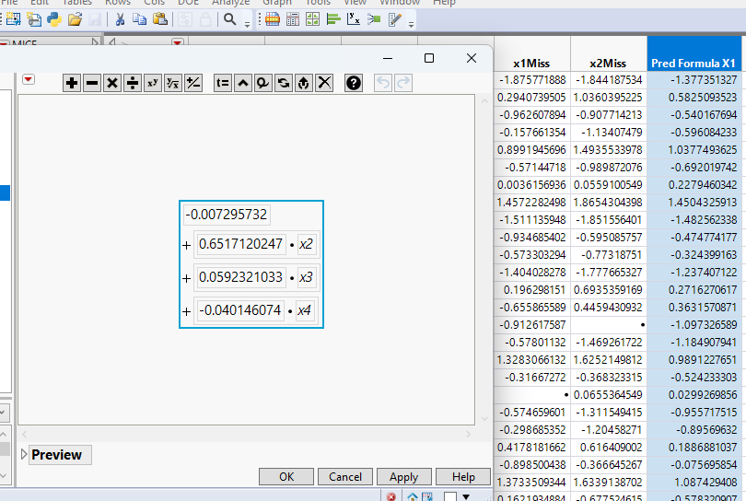
How about just a conditional model?

